Slide 1
Unicorn company valuation and investor analysis
Monika Singh
NYC data Science Academy, New York
5/9/2022

Slide 2
Motivation
“Unicorn startup” refers to a private company valued at or over $1 billion
The term “unicorn startup” (often shortened to just “unicorn”) was coined in 2013 by venture capitalist Aileen Lee.
When Lee coined the term, there were 39 unicorns.

Slide 3
Motivation
According to Get2Growth:
About 305 million startups are created annually.
About 472 million entrepreneurs in the world.
According to 2019 Investopedia statistics, about 90% of newly created startups do not succeed.
Of the startups that do succeed a very small number of them become Unicorns
The elite club of Unicorns has its own elite
Unicorns vary greatly in value from $1 to $100 billion

Slide 4
Goals
Of those companies that are Unicorns, what features impact their valuation?
What can we learn about the investors who invest in Unicorns?

Slide 5
Dataset
Data set: https://www.kaggle.com/datasets/deepcontractor/unicorn-companies-dataset
1,037 Unicorns
13 Features

Slide 6
Features
Company
Valuation in billions
Date joined
Country
City
Industry
Investors
Year founded
Total raised
Financial stage
Investors count
Deal terms
Portfolio exits

Slide 7
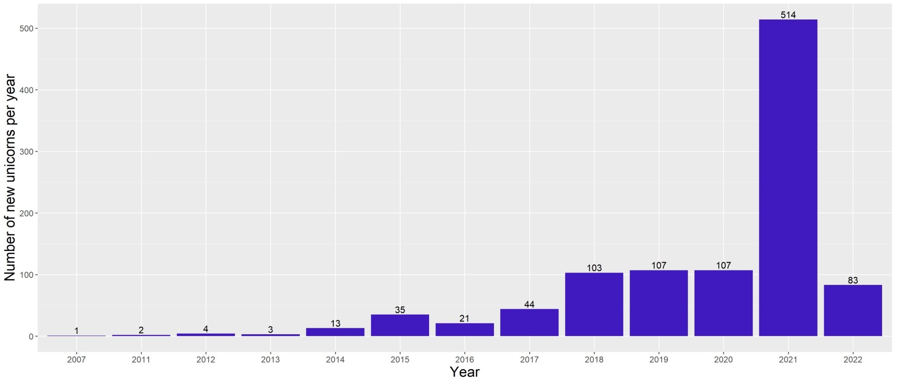
Number of new unicorns per year

Slide 8
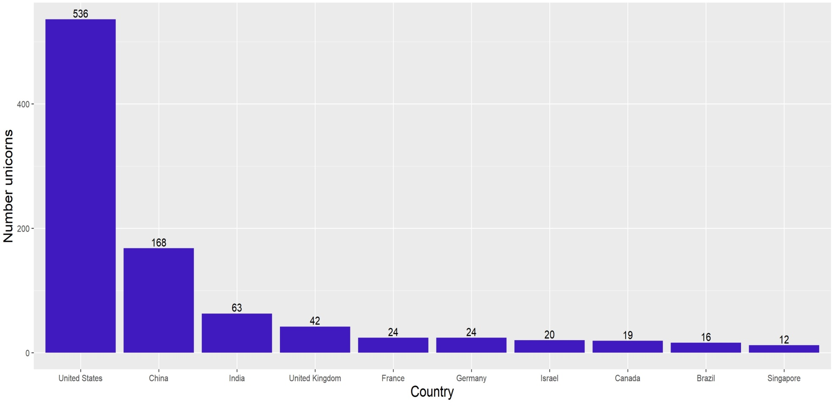
Unicorns per country (top ten)
36 other countries
Number of Unicorns: 113

Slide 9
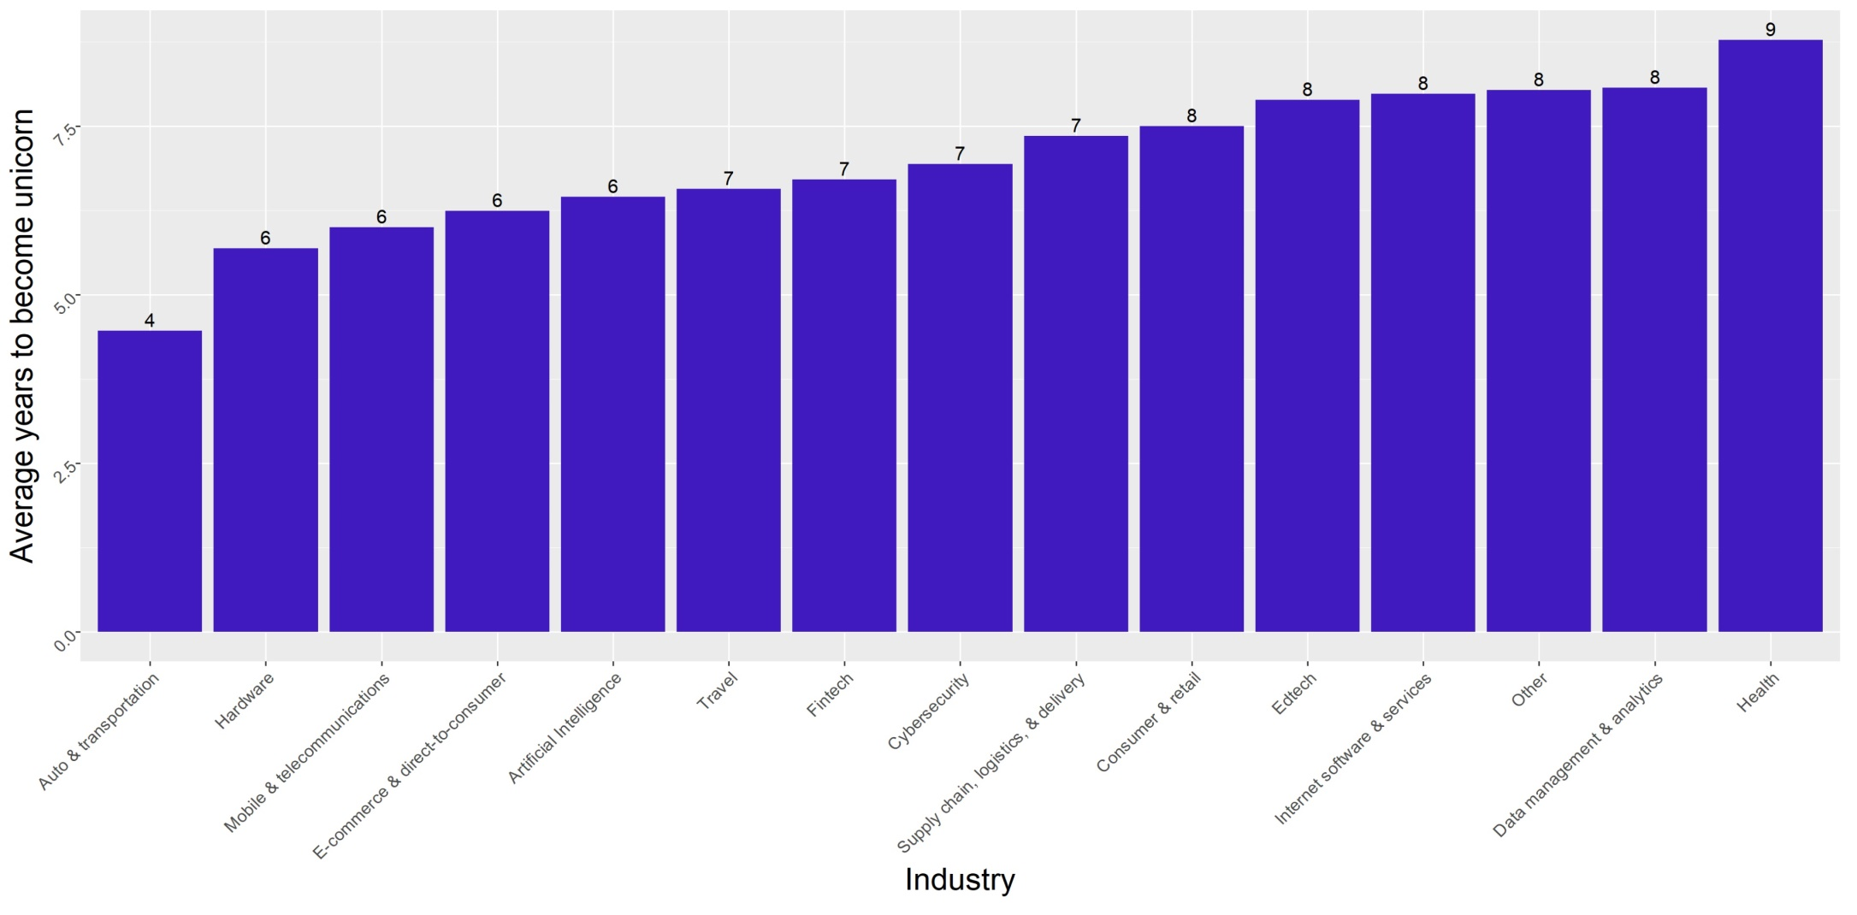
Industry

Slide 10
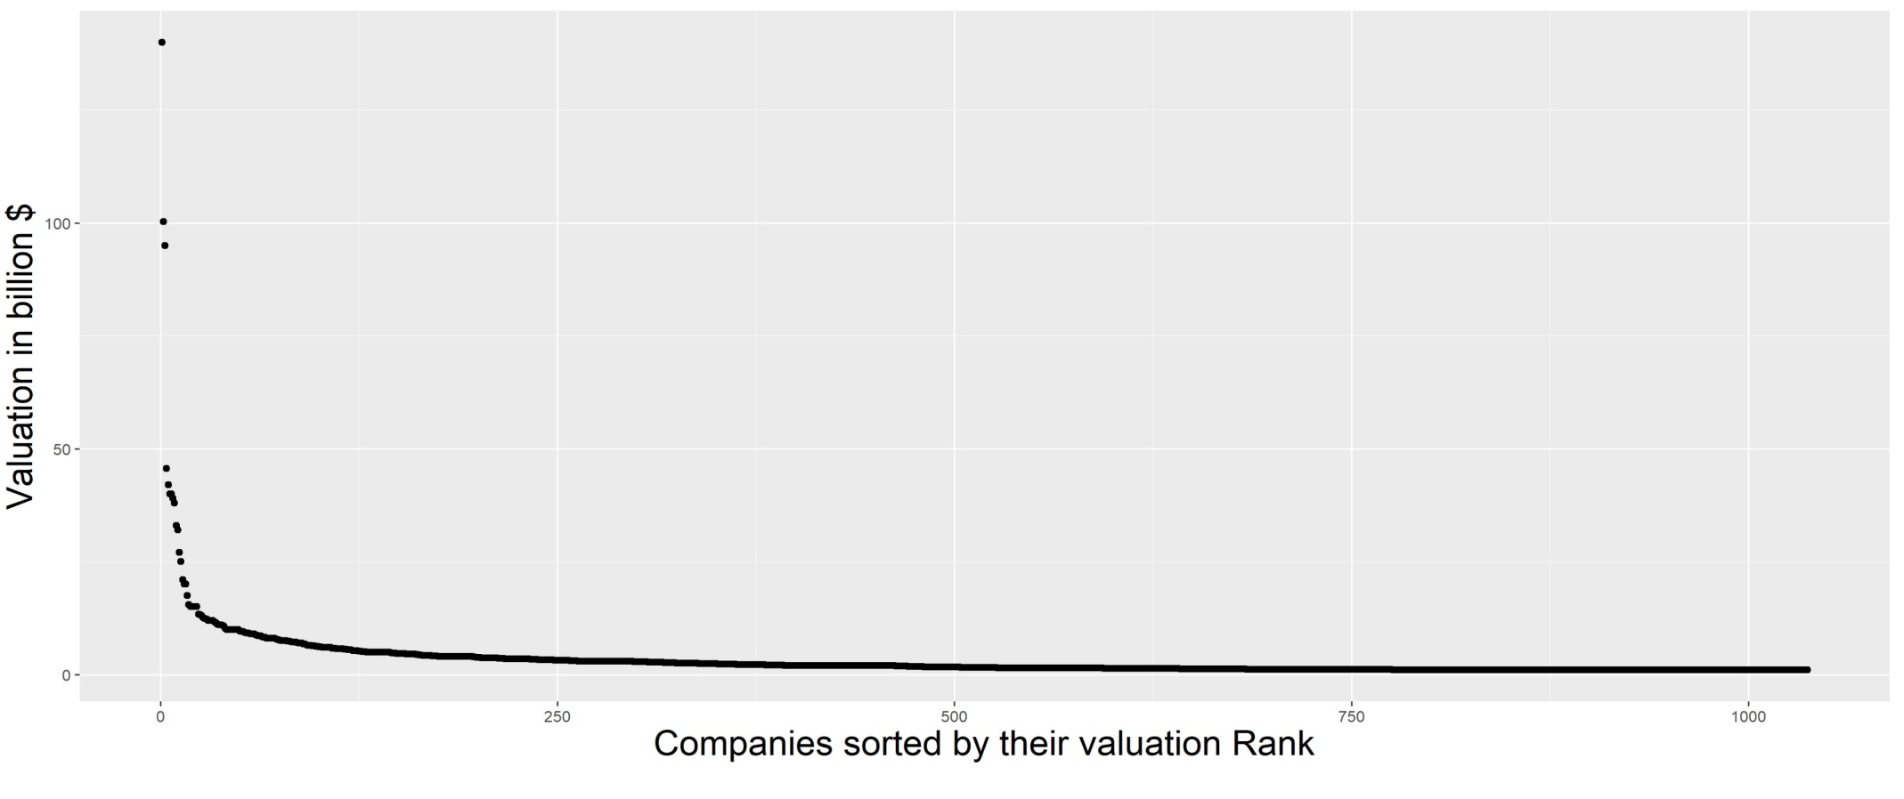
Valuation

Slide 11
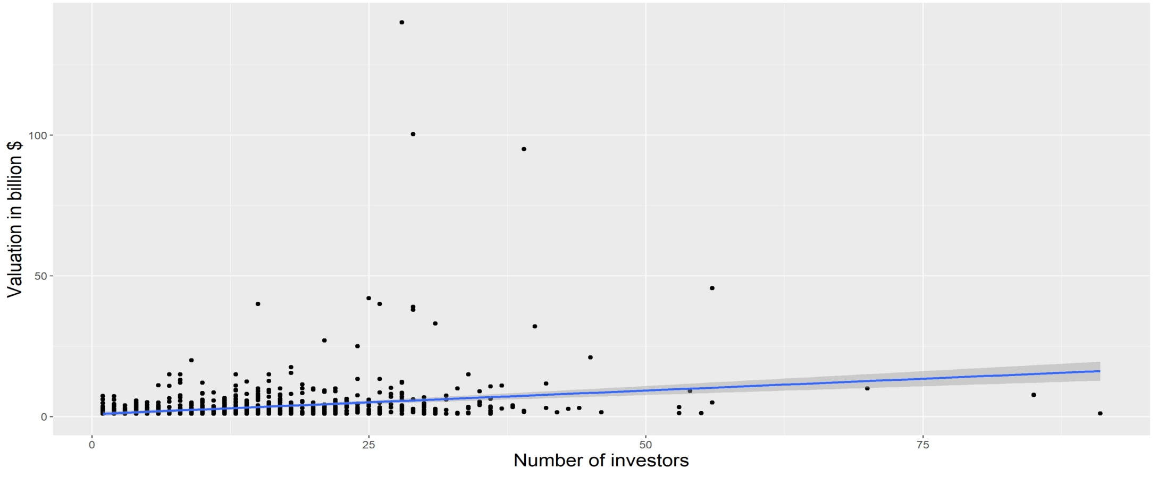
Valuation versus Number of Investors
Valuation = $167 million * (number of investors) + $86 million

Slide 12
Multi-variable analysis
Analysis of number of investors and years since founding on the valuation of the company.
All unicorns
Valuation = $185 million * (# of investors) + $136 million * (years since founding) – $640 million

Slide 13
Multi-variable analysis
Analysis of number of investors and years since founding on the valuation of the company.
Motivation for studying U.S. and China unicorns separately:
The U.S. and China have different political and economic systems, which we would expect to impact startup valuations.
All unicorns
Valuation = $185 million * (# of investors) + $136 million * (years since founding) – $640 million
U.S. unicorns
Valuation = $159 million * (# of investors) + $238 million * (years since founding) – $1.09 billion

Slide 14
Multi-variable analysis
Analysis of number of investors and years since founding on the valuation of the company.
Motivation for studying U.S. and China unicorns separately:
The U.S. and China have different political and economic systems, which we would expect to impact startup valuations.
All unicorns
Valuation = $185 million * (# of investors) + $136 million * (years since founding) – $640 million
U.S. unicorns
Valuation = $159 million * (# of investors) + $238 million * (years since founding) – $1.09 billion
China unicorns
Valuation = $234 million * (# of investors) + $170 million * (years since founding) – $1.17 billion

Slide 15
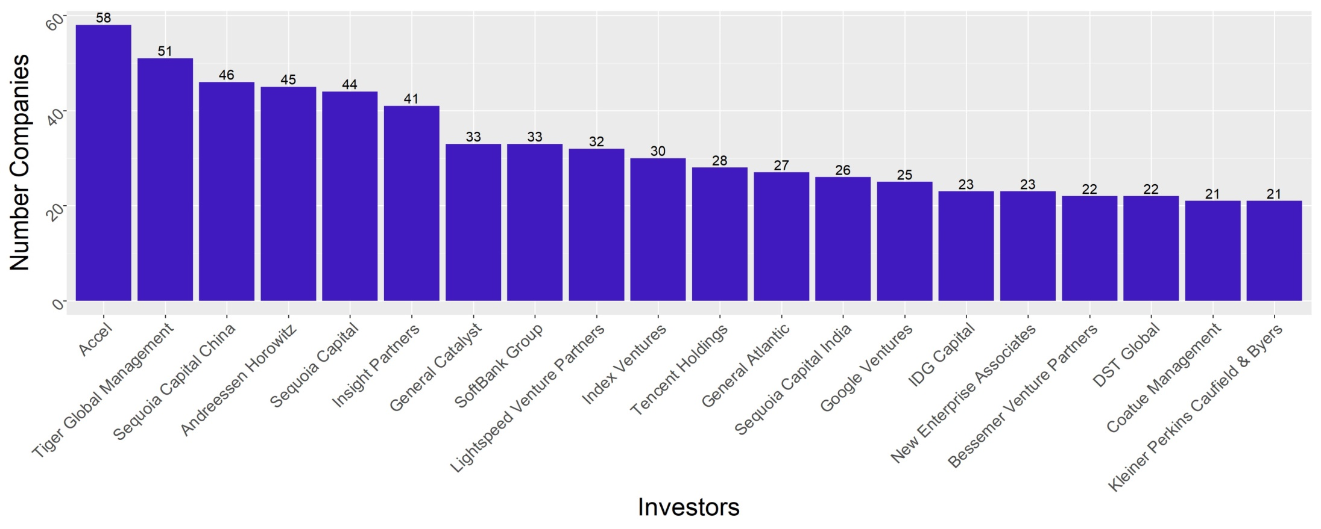
The top 20 unicorn investors

Slide 16
The top 20 unicorn investors
Total number of investors = 1231
828 investors (67% of all investors) have only invested in one unicorn

Slide 17
To what degree do groups of investors invest in the same companies?
Motivation:
If an entrepreneur gets one investor what other investors are they likely to get as well?
n-Tuple
(Investor₁, Investor₂,…, Investor_{n})
Number of unicorn companies they invested together.

Slide 18
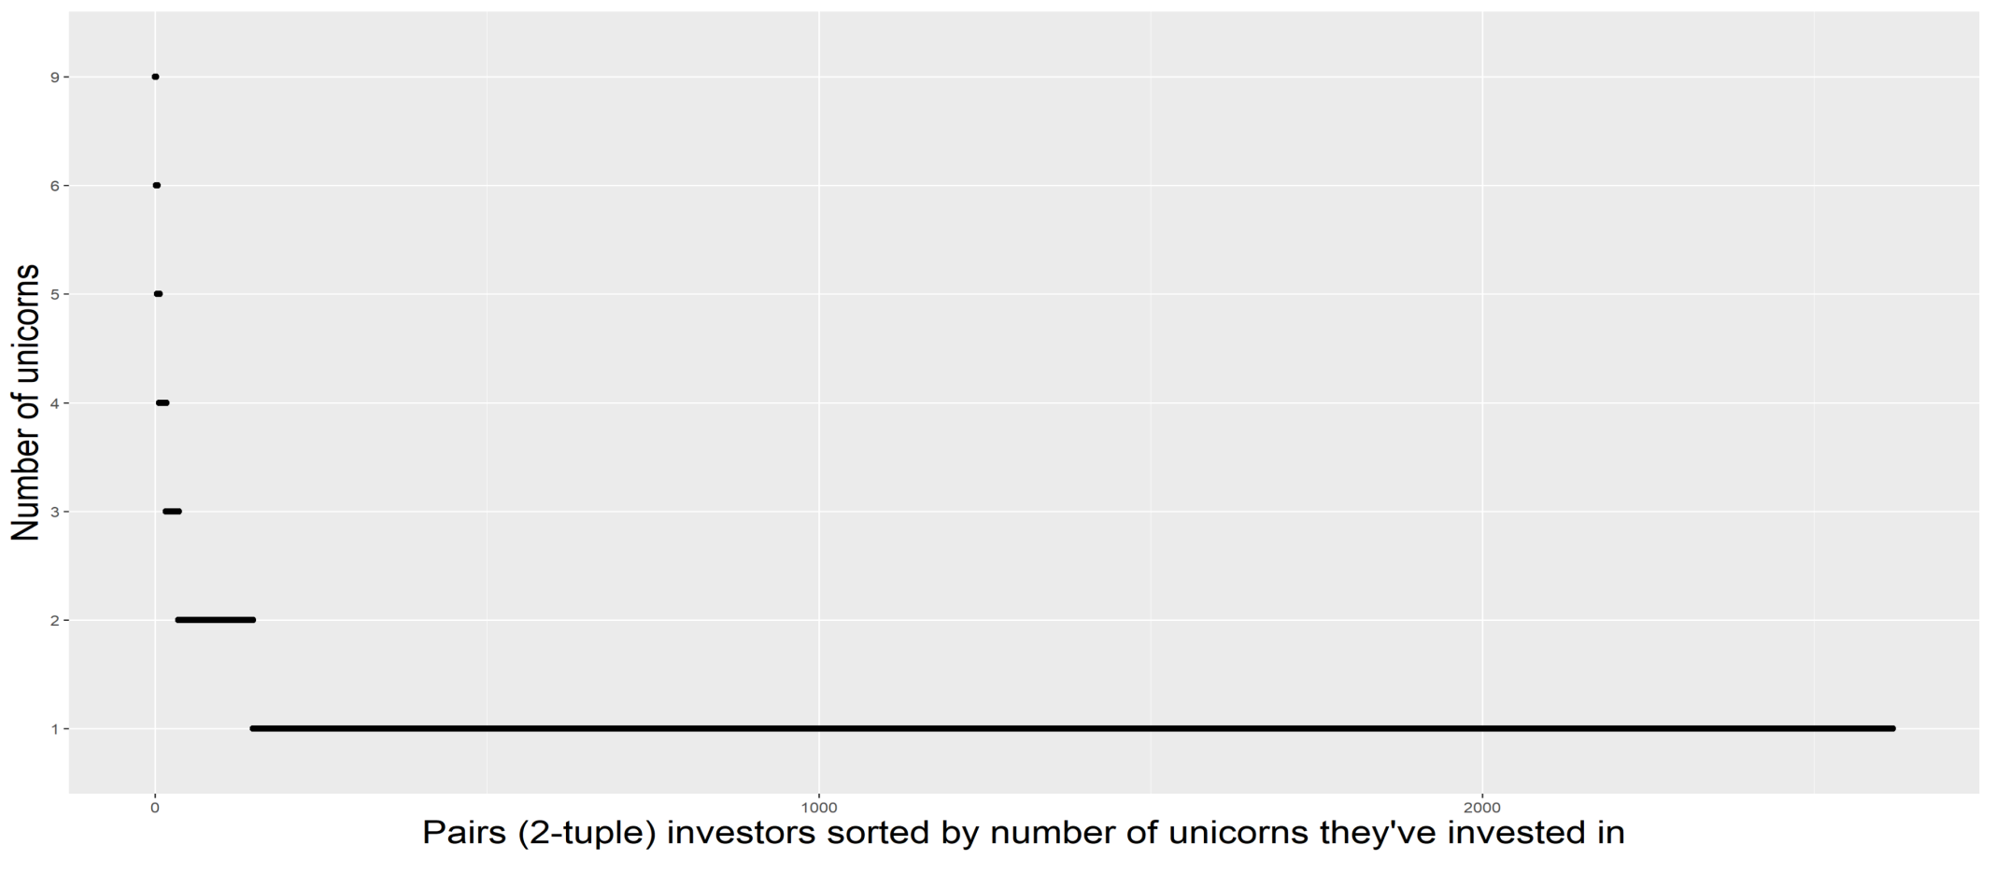
Investor analysis (2-tuple)

Slide 19
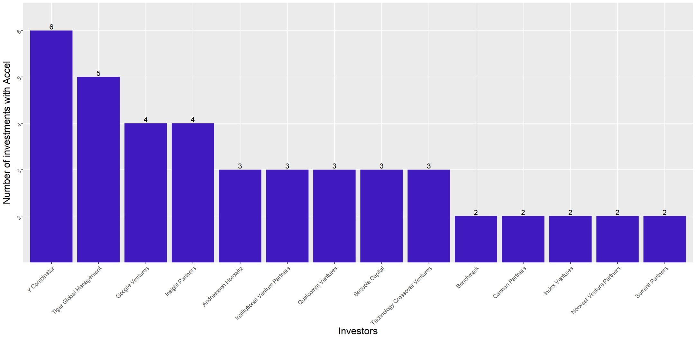
Investor analysis (2-tuple) for Accel

Slide 20
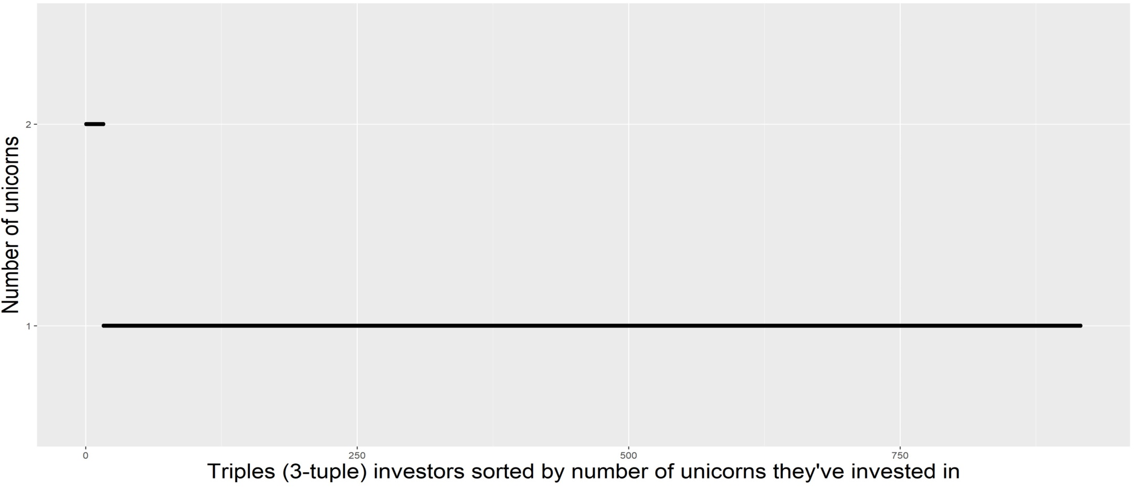
Investor analysis (3-tuple)

Slide 21
Key conclusions & future work
Key conclusions
The most important factor for predicting valuation depends upon the country
USA: years since founding
China: number of investors
Unicorn company CEO’s should use 2-tuple analysis to find their next investor
Future work:
Extend analysis to high value (over $100 million) startups.

